Slide 1
Recognition of Prior Learning (RPL) in Industrial Shoe Production
Andreas Saniter, Vivian Harberts, VETNET, ECER Glasgow, 24.08.2023

Slide 2
Agenda
Context
Some questions and methods
Chosen findings
Focus on Recognition of Prior Learning (RPL)
“Our” highlight
SWOT
SWOT: Strengths/Weaknesses/Opportunities/Threats analyses

Slide 3
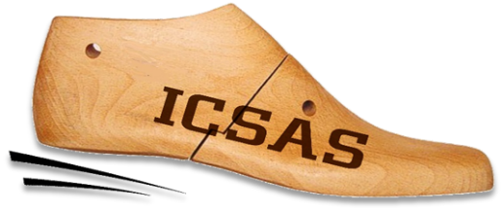
Context
2 projects in the sector that focus (besides other) on RPL
2017-2020:
2020-2023:

Slide 4
Context
2017-2020:
Integrating Companies in a Sustainable Apprenticeship System (ICSAS)
E+, via NA/BIBB, 3 years
Countries: PT, ES, DE, RO
Target group: Apprentices, EQF-Level 2-4
Partners: Shoe competence centres, companies, universities
EQF: European Qualification Framework

Slide 5
Context
2020-2023:
Developing (and piloting) Innovative and Attractive CVET programmes (DIA-CVET)
E+, via NA/BIBB, 3 years
Countries: PT, DE, RO
Target group: skilled workers, students (HE), EQF-Level 5-7
Partners: Shoe competence centres, companies, universities

Slide 6
Chosen questions and methods
To identify Spheres of Activity (SoA) of IVET and (potential) CVET-qualifications.
Desk-top research, Learning Station Analyses (LSA), Expert-worker WS (EWW)
Is there an added value of an SQF on levels 5-7?
extension of SQF level 2-4 of previous project
Expert-interviews
Which methods of RPL are legally applicable and of added value?
Expert-interviews, desk-top research
SQF: Sector Qualification Framework

Slide 7
Chosen findings
9 SoA (f. e. “cutting”) have been identified for IVET.
13 SoA (f. e. sustainability management) have been identified for CVET/HE.
4 of the identified SoA are (partly) part of both educational tracks.
Skilled work in the sector can thus be described via 18 SoA.
SQF increase the transparency and permeability, but bear the risk of “plug and play” micro-credentials.

Slide 8
Recognition of Prior Learning (RPL)
High on the “official” policy agenda in all 3 countries (DE, PT, RO)
Structural and individual RPL must be differentiated
3 approaches towards recognition:
Evidence of prior learning (e. g. portfolio or certificate)
Evidence + assessment
Evidence + mandatory lessons + assessment

Slide 9
Recognition of Prior Learning (RPL)
Formal laws in RO and PT, in DE an ordinance
Country-wide procedures (portfolios, delta-analyses, individualised training, assessment) and one competent body (ANQEP) in PT.
In RO, legal entities are authorized for groups of qualifications (for example metalworking); procedure might differ between sectors.
In DE the 79 regional chambers are responsible (in VET); in HE each university (professor) decides.
ANQEP: National Agency for Qualification and Vocational Education

Slide 10
RPL: Application in DIA-VET
In DE : no application (IVET precondition for industrial foremen)
IN RO: Informal minor application in the piloting phase of the project (learners with previous skills have to attend less lessons)
In PT: RPL core of the piloting (5 units of 1 month, each); aim: level 5 qualification (design)

Slide 11
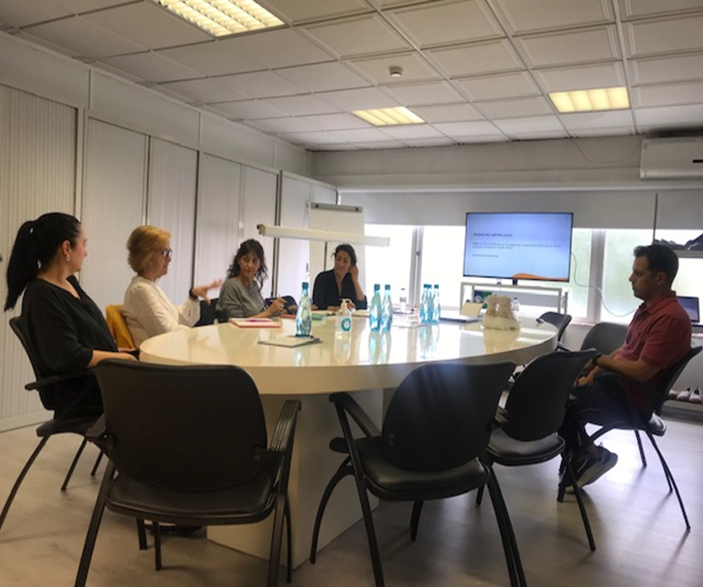
Our highlight: Recognition, Validation and certification of competences (RVCC) – Certification “Designer” (QL 5) in PT
Participant – Employee of the company Carité (skilled on level 4, working for years in the design department).
Certification Jury - Qualifica Coordinator / RVCC Technique, Trainers, Union Representative and Representative of the business sector.
NOTE - Incentive Qualifica: The certified participant receives a grant of €600 paid by ANQEP.
NOTE 2 - First person in PT who received a level 5 qualification via RPL!
.

Slide 12
SWOT (all countries)
Strengths | Weaknesses
A brought variety of measures Adaptable to various sectors/qualification levels/ preconditions | Influenced by non-educational themes (economics, beliefs,…) Need of engaged participants or mentors
Opportunities | Threats
Increase the amount of holders of recognised qualifications Increase the opportunities of persons with broken educational careers | Might undermine established qualification systems Might lower standards
None of the measures is the “silver bullet”

Slide 13
Many thanks for listening, questions and suggestions!
Now
-
Or later:
Vivian Harberts,
Andreas Saniter ITB Uni Bremen, DE asaniter@uni-bremen.de
harberts@uni-Bremen.de
http://icsas-project.eu
https://dia-cvet.eu

